Slide 1
Bridges

Slide 2
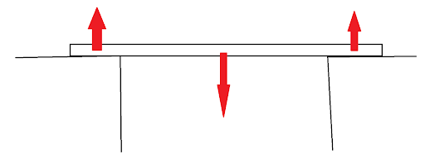
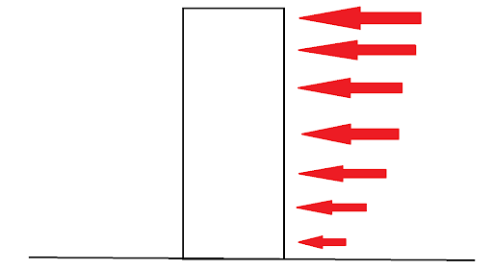
First, some discussion on forces

Slide 3
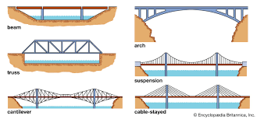
Different types of bridge structures
Notes:
Beam bridge strengths and weaknesses:
Cost effective, many material choices, Fast construction times, Functional, many design options
Not good look appeal, Limited span
Arch bridge strengths and weaknesses:
Can span large distances, many different design options Better level of resistance to forces
Tough to design, Arch must be perfect, Provides a finite span with each set of Abutments
Truss bridge strengths and weaknesses:
Large load can be placed on it, Effective use of materials, Cheap to make, Versatile and adaptable design
Larger width required, Need smart design to be efficient, Plenty of maintenance needed
Suspension bridges:
Cheap to make as they can span long distances, Can be built to be tall so ships can pass, Fast to build
Less flexibility, Unstable with high wind or concentrated loads, Access below the deck needed for maintenance
Cantilever bridge:
Very strong so can support high loads, Simple to make, Less material, Seamless design
If not constructed with sturdy teeth the bridge could collapse, Very heavy
Cable-stayed bridge:
Fast to build and quite rigid
Only good for medium-short distances, Unstable in certain environments

Slide 4
Finite element analysis (FEA) with Fusion 360
Set your material to Polystyrene
Select the object you want to perform FEA on
Select a constrained face
Add a static load
Wait for results

Slide 5
DESIGNING YOUR OWN BRIDGE!!!
Research designs of truss bridges
Use Fusion 360 to design a truss bridge across a 20cm gap
Design Requirements:
The bridge must be 30mm wide
Cannot be taller than 50mm
Beams can be at most 3mm thick
Use less than 50 grams of material in total after slicing
Perform finite element analysis on the bridge under different loads
Make multiple design iterations to find the optimal design

